Slide 1
Pokerbots 2023
Lecture 2: Poker Theory

Slide 2













Sponsors
Notes:
Shreyas
---

Slide 3
Resume Drop

Slide 4
Resume Drop: pkr.bot/drop

Slide 5
Giveaway

Slide 6
Giveaway: pkr.bot/lec-2

Slide 7
Logistics

Slide 8
Find Teammates!
Piazza post @5 & @16

Slide 9
Afternoon Poker Session:
TODAY 1/11
3-5pm @ 2-131 & 2-132

Slide 10
Week 1 bot deadline:
Friday Jan 13, 11:59 p.m.

Slide 11
Agenda
Main Principles
Hand types
Pot odds
Implied odds
Ranges
Variant strategic considerations
Coding reference-lecture-2 bot

Slide 12
Main Principles

Slide 13
No. 1: The Strength Principle
Bet your strong hands
Check your middling hands
Fold or bluff with your weakest hands

Slide 14
No. 2: The Aggression Principle
In general Aggression (betting and raising) is better than passivity (checking and calling)
Gives you two ways to win
Opponent can fold to you bet
Can call you bet and you can win at the showdown

Slide 15
No. 3: The Betting Principle
A successful bet is able to do one of three things:
Force a better to fold
Force a weaker hand to call
Cause a drawing hand to draw at unfavorable odds

Slide 16
No. 4: The Deception Principle
Never do anything all the time

Slide 17
Hand types

Slide 18
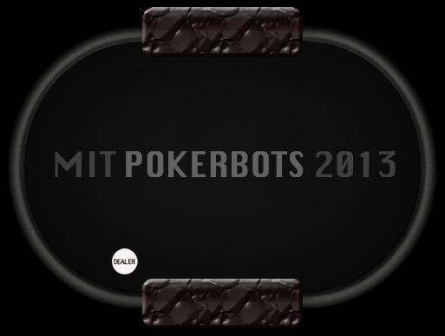







Drawing hand

Slide 19
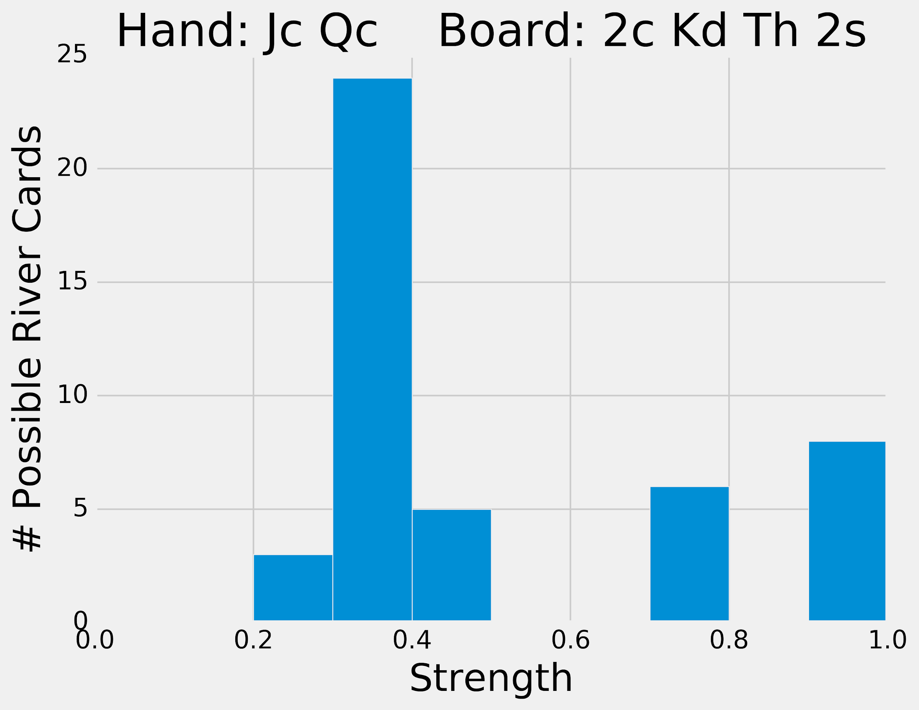
Drawing hand

Slide 20


Low pair

Slide 21
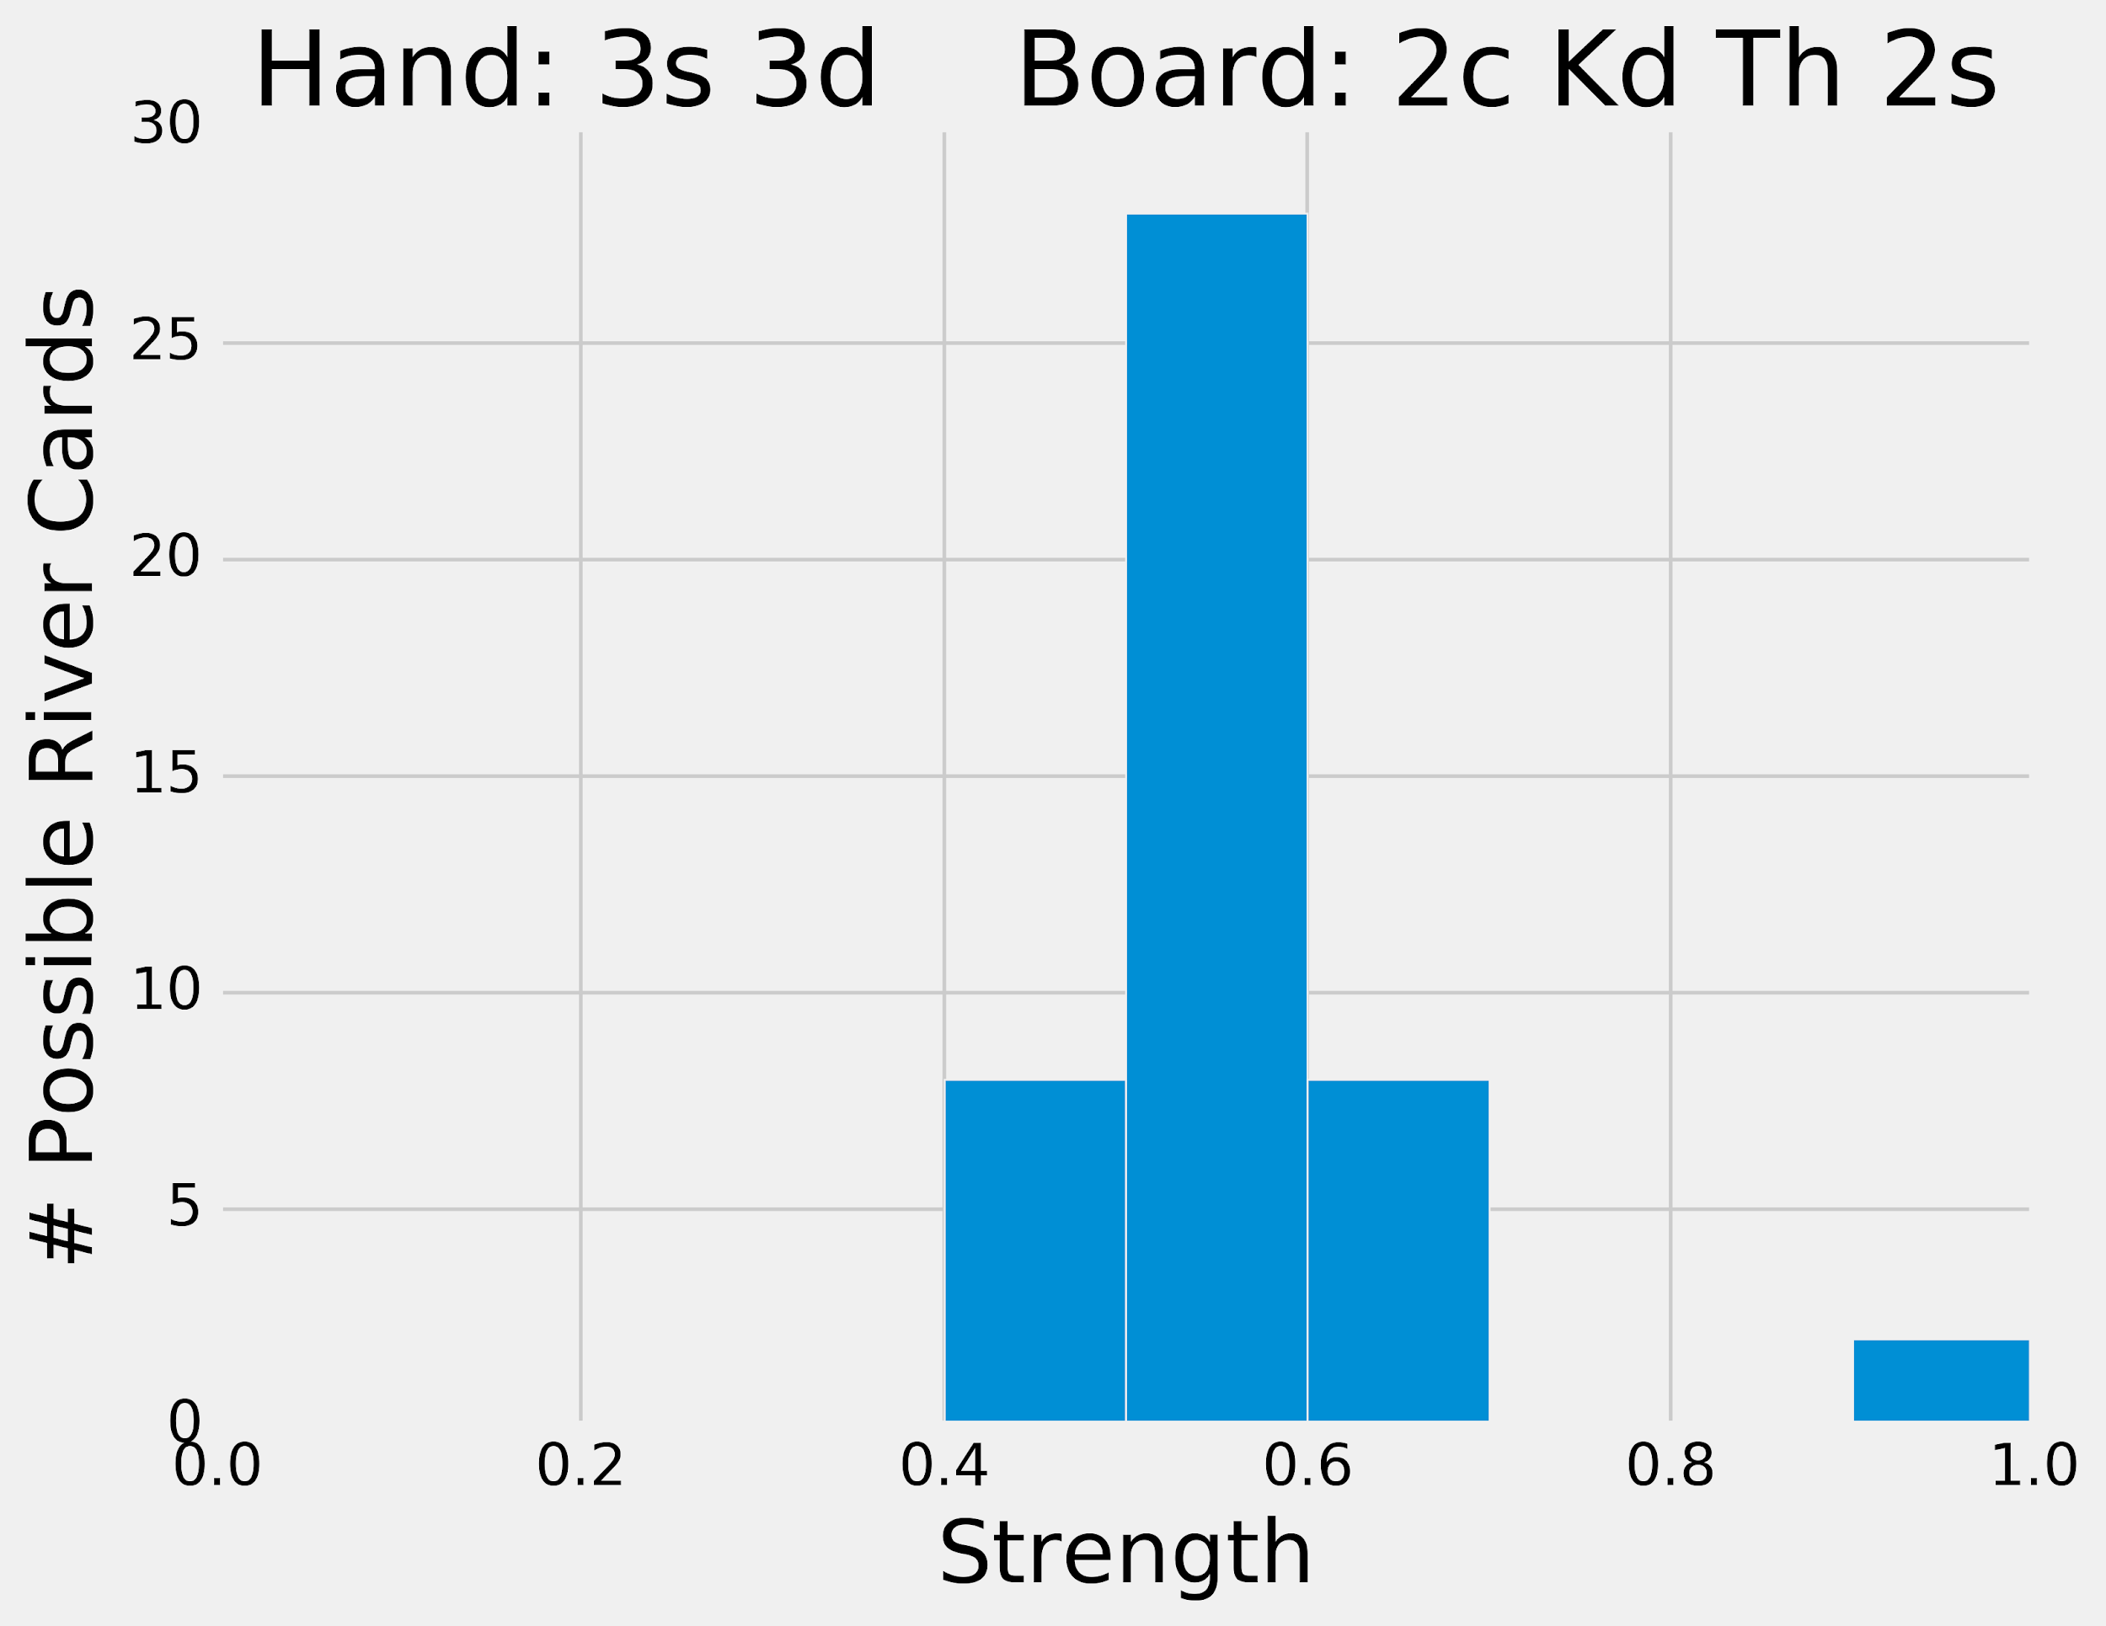
Low pair

Slide 22


Made hand

Slide 23
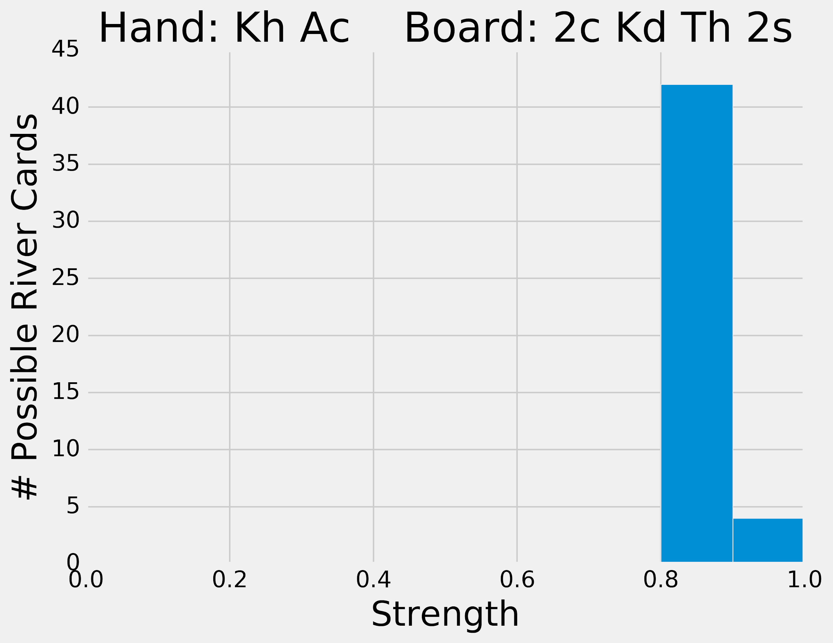
Made hand

Slide 24


“The nuts”

Slide 25
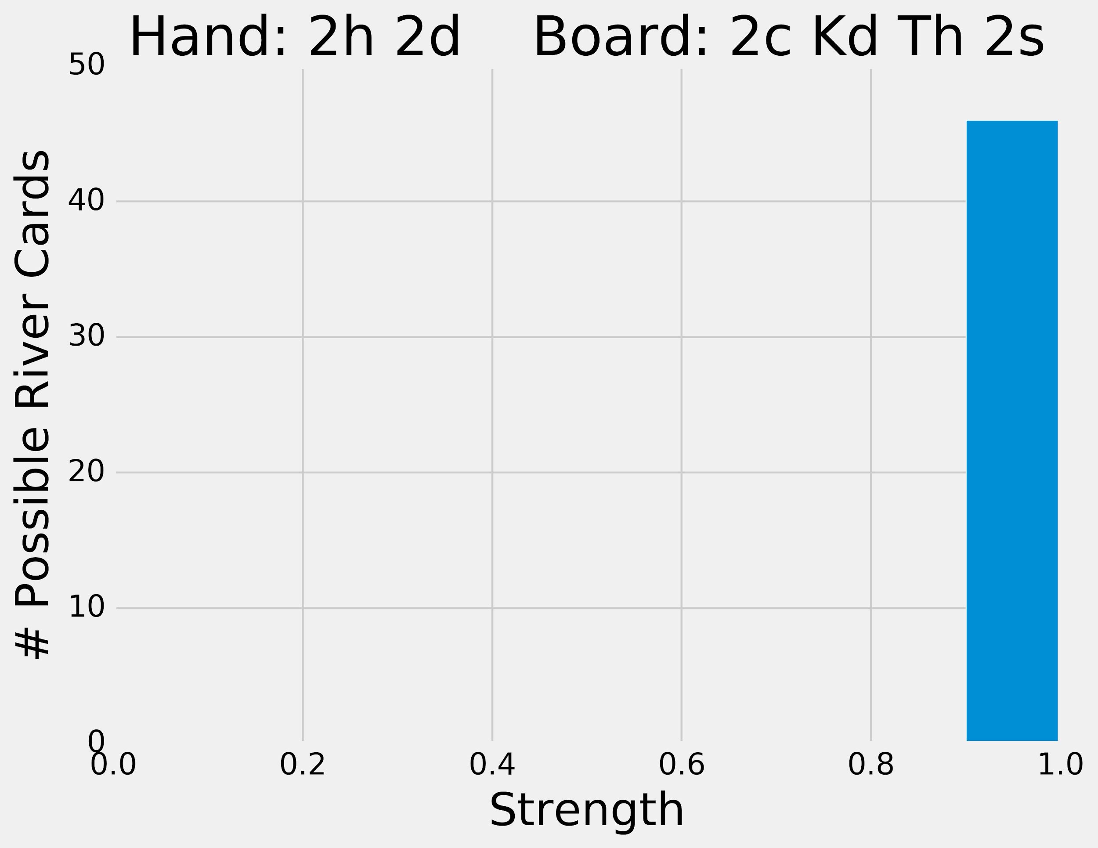
“The nuts”

Slide 26
Board types

Slide 27


How would you feel about your hand strength here?

Slide 28




What about here?

Slide 29
Pot Odds & Outs

Slide 30
Pot odds
Claim: for any state of the game, there exists some probability p of winning
This depends on our opponent’s strategy, but let’s ignore that for now
0 ≤ p ≤ 1

Slide 31
Calculate expected value
p · pot_total − (1 − p) · continue_cost
>0?
=0?
<0?

Slide 32
Separate p
Cutoff: we should stay in the game if
p ≥ continue_cost / (pot_total + continue_cost)
Right-hand side is called the pot odds

Slide 33

Exercise
40
40
Notes:
Here we’ve reached a game state where both players have contributed 40 chips to the pot thus far

Slide 34
Exercise
50?
40
Notes:
Our opponent raises his bet by 10 chips. The question now becomes “do we call their raise?”.

Slide 35
Example pot odds
pot_total = 90
continue_cost = 10
pot odds = 10 / (90 + 10) = 0.1
If p ≥ 0.1, we should call!
How do we know what p is?
Notes:
We use pot odds to answer that

Slide 36
Counting outs
Idea: If we know which cards we need to complete our hand, we can estimate the probability of getting those cards. If our hand is strong, this estimates our probability of winning the game (p)!
Strategy:
Count the number of cards that complete our hand (outs)
Multiply this number by 2 (52 cards gives ~2% chance of getting a specific card)
If we have two cards left to see, multiply by 2
This number is our probability estimate! (as a percent)

Slide 37
Exercise
50?
40

Slide 38
Calculating p
outs = 8
probability of completing the hand is 8 * 2 = 16%
p = 0.16
pot odds = 0.1
p is greater than our pot odds - we should call!
Notes:
We use pot odds to answer that

Slide 39
Reverse pot odds
If we overbet relative to the size of the pot, then we give our opponent the opportunity to exploit pot odds
If they have a bad hand, we win a little
If they have “the nuts,” we lose a lot

Slide 40
Example: the all-in bot
Our opponent goes all-in on the preflop (deterministic!)
We can check-fold, letting our opponent collect the blinds, until we are dealt a high pair to crush them and win big

Slide 41
Implied and Reverse Implied Odds

Slide 42
Implied Odds
The amount of money you expect to win on later streets if you hit one of your outs
Enables us to call when we don't have the right pot odds
Mostly important when calling with a drawing hand

Slide 43
Updated p
Pot odds cutoff: we should stay in the game if
p ≥ continue_cost / (pot_total + continue_cost)
Implied odds cutoff: we should stay in the game if
p ≥ continue_cost / (pot_total + continue_cost+ amount_you_expect_to_win)
Sometimes you need to factor in calling on the Run

Slide 44
Exercise
40
40
Notes:
Here we’ve reached a game state where both players have contributed 40 chips to the pot thus far

Slide 45
Exercise
60?
40

Slide 46
Pot odds revisited
pot_total = 100
continue_cost = 20
pot odds = 20 / (100 + 20) = 0.167
probability of completing the hand is 8 * 2 = 16%
From counting outs, p = 0.16
Pot odds tell us to fold!
Notes:
We use pot odds to answer that

Slide 47
Implied Odds
Assumption: our opponent been always betting, and will continue to bet ¼ pot
pot_total = 100, continue_cost = 20, next_bet = ¼ * (120) = 30
pot odds = 20 / (100 + 20 + 30) = 0.133
From counting outs, p = 0.16
Implied odds tell us to call!
Notes:
We use pot odds to answer that

Slide 48
Reverse Implied Odds
This is the amount you could expect to lose after hitting your draw
Balances out implied odds, and together they provide a better estimate of your true pot odds
Warns us to be careful when we're not drawing to "the nuts"
Notes:
We use pot odds to answer that

Slide 49
Exercise
40
40
Notes:
Here we’ve reached a game state where both players have contributed 40 chips to the pot thus far

Slide 50
Exercise
60?
40

Slide 51
Exercise
60
60
Notes:
Here we’ve reached a game state where both players have contributed 40 chips to the pot thus far

Slide 52
Exercise
60
60
Notes:
Here we’ve reached a game state where both players have contributed 40 chips to the pot thus far

Slide 53
Exercise
90?
60
Notes:
Here we’ve reached a game state where both players have contributed 40 chips to the pot thus far

Slide 54
Exercise
90
90
Notes:
Here we’ve reached a game state where both players have contributed 40 chips to the pot thus far

Slide 55
Exercise
90
90
Notes:
Here we’ve reached a game state where both players have contributed 40 chips to the pot thus far

Slide 56
Ranges

Slide 57
Ranges
We know the pot odds when faced with any bet
If we can estimate p better than our opponent, then we will make money on average
What affects p?

Slide 58
Factors of win probability
Bluffing
Betting style
Board and Hole cards
Ranges

Slide 59
Our opponent’s range is the distribution of hands we expect them to hold

Slide 60
Updating Ranges
Use opponents actions to narrow range
"Everything conveys information"
How do your cards compare to their range?
What about your range?

Slide 61
Which ranges are good?
Tight-aggressive
Fold early and often to mitigate losses
Bet and win when you have a good hand!

Slide 62
Variant strategic considerations

Slide 63
River of Blood Hold’em
All odds are inflated given extended board
About 50% chance there will be more than 5 cards played
Consider ranges in the context of the number of streets played in the round
Remember cards in your hands are "blockers"
If bots are betting randomly, wait for a good time to trap them on the later streets

Slide 64
Coding reference-lecture-2 bot

Slide 65
Goals
Improve our betting strategy
Implement pot odds
Incorporate randomness
Monte Carlo simulation for card strength estimation (p)

Slide 66
Monte Carlo Simulation
Helps us estimate values by using randomness and sampling
Simulates a process many times to see what happens on average
We can estimate our hand strength by simulating poker games many times
The proportion of wins from the simulations is our win probability!

Slide 67
Giveaway Winner

Slide 68
480.1 MB

